Slide 1
Salesman Ordering & Tracking Web Application
Project Supervisor
Mr.Fayaz Ahmad Fayaz Project By:
1.Adnan Shafi
2.Farhan Farooq 3.Sajid Nisar

Slide 2
Objective
The main objective of this Web Application is to learn and implement an affordable real-time location tracking and automation of order process and other business related things.
Helps business owners to keep track of their field staff’s activities, their orders, attendance and other things from a single dashboard.
Helps field staff to eliminate manual work by simply passing orders, checking current stock, collection of parties outstanding ,EOD reports,attendances,expenses from a single panel.

Slide 3
Features/Modules
Order Automation: Track orders received by salesman/sales employee.
Payment & Collection Automation: Track salesman payments & collections done.
Location Tracking of Employees: Track sales employees/sales people locations.
Attendance Management: Track field employee
Activities Management: Update your salesman/sales employee about the task they need to carry out and track their daily activities.
Parties Management: Add new parties with ease and manage parties at your fingertips.

Slide 4
.
Product Management: Create and update your product details.
Announcements: Create announcements and update all your salesmen at once.
Automated Report & Analytics: Streamline reports of each salesman including their working hours, distance travelled, GPS locations, orders and collections.
Live feed update :Business owners can check live feed of their field staff

Slide 5
TECHNOLOGIES /SOFTWARES USED
Front-End: HTML 5, CSS 3, JAVASCRIPT, JQUERY, BOOTSRAP, AJAX.
Back-End: PHP
Database:MY SQL.
IDE:Sublime Text ,Vs code.

Slide 6
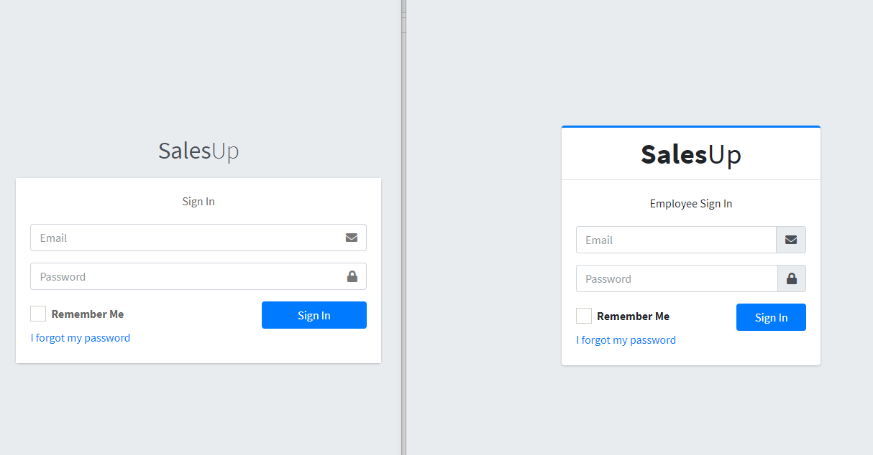
LOGIN FOR ADMIN & EMPLOYEE
.

Slide 7
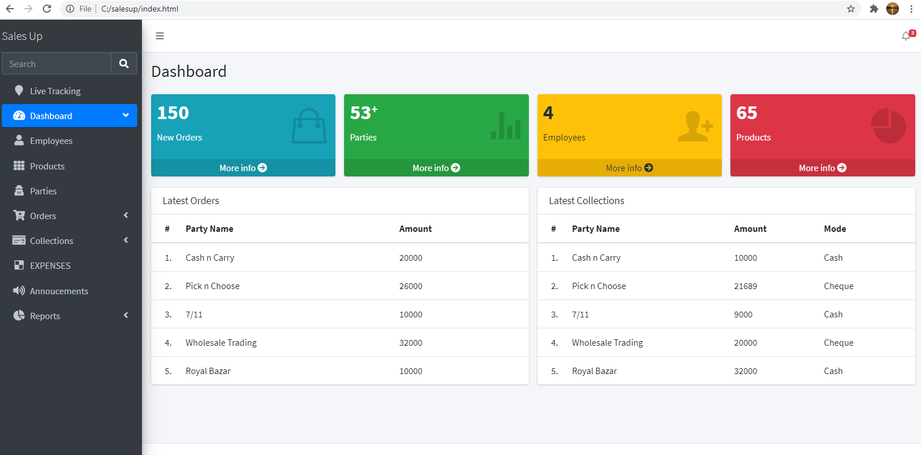
ADMIN DASHBOARD

Slide 8
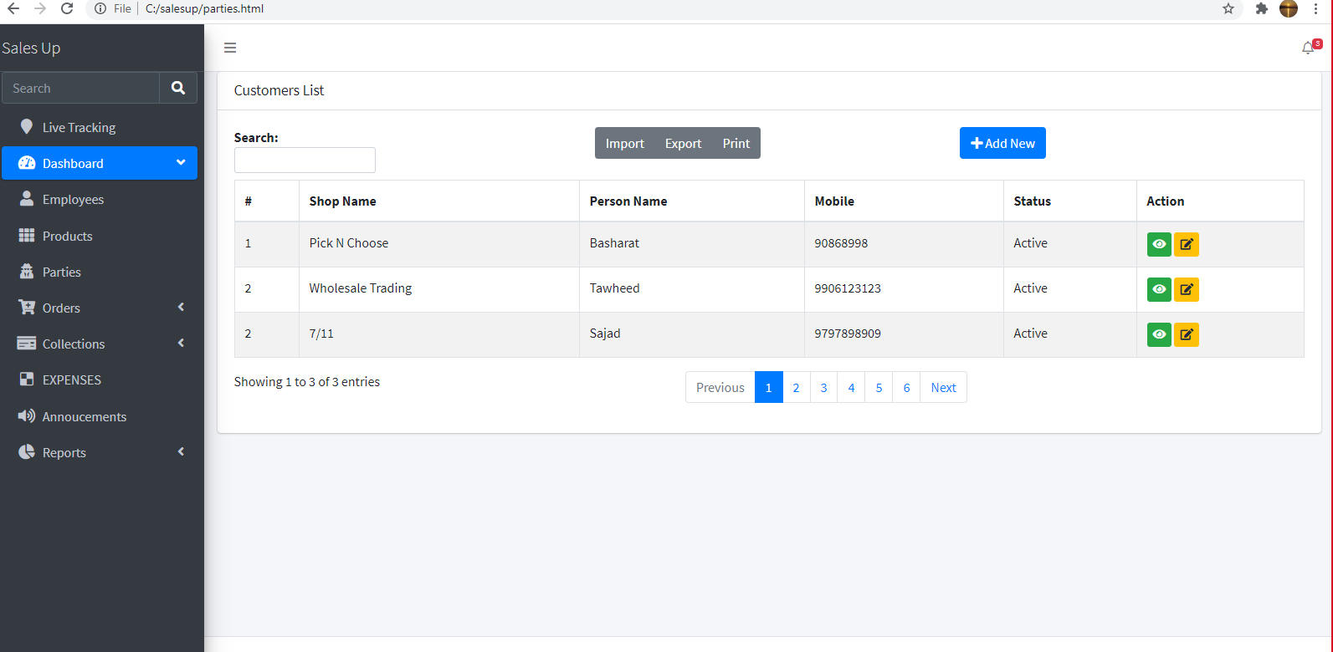
VIEW PARTIES

Slide 9
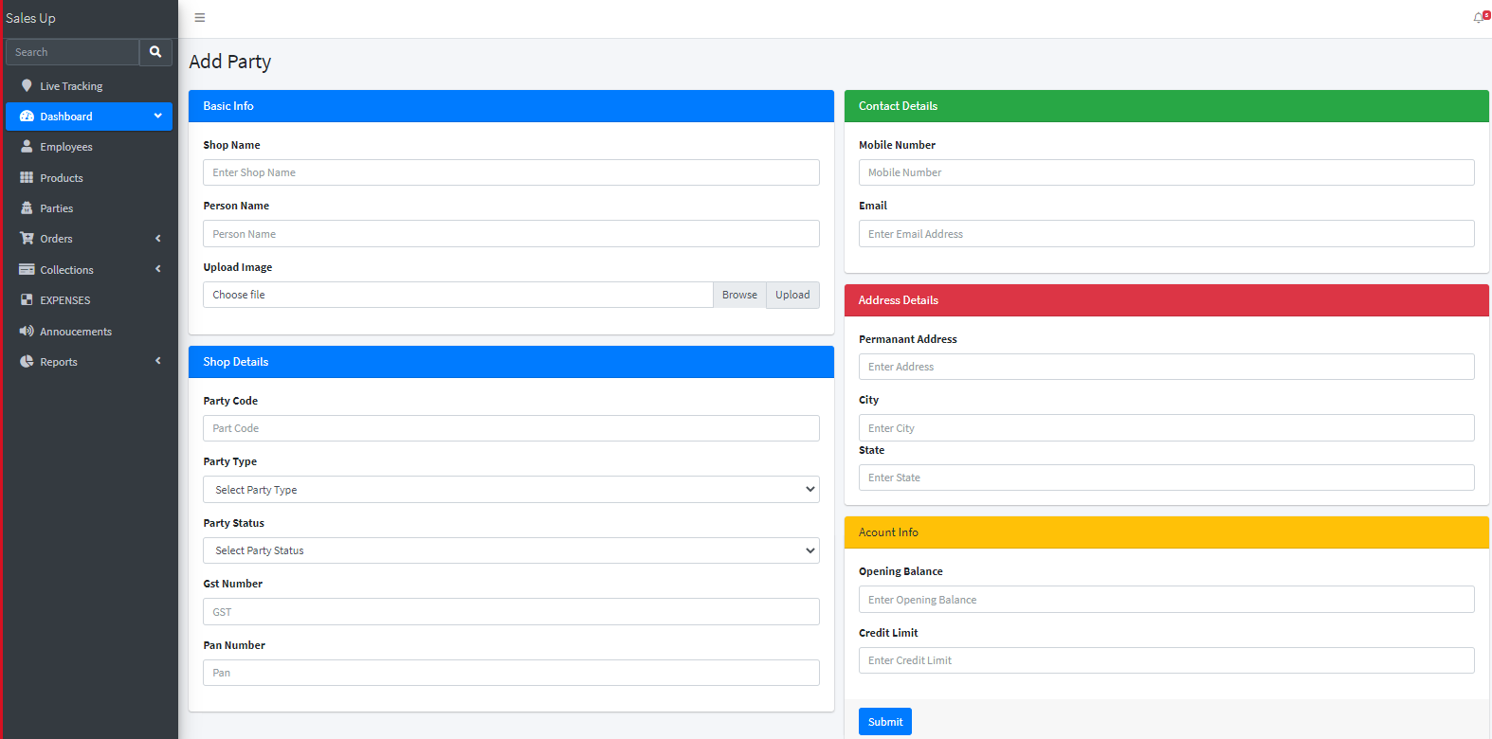
Add Party-admin/user will be able to add parties

Slide 10
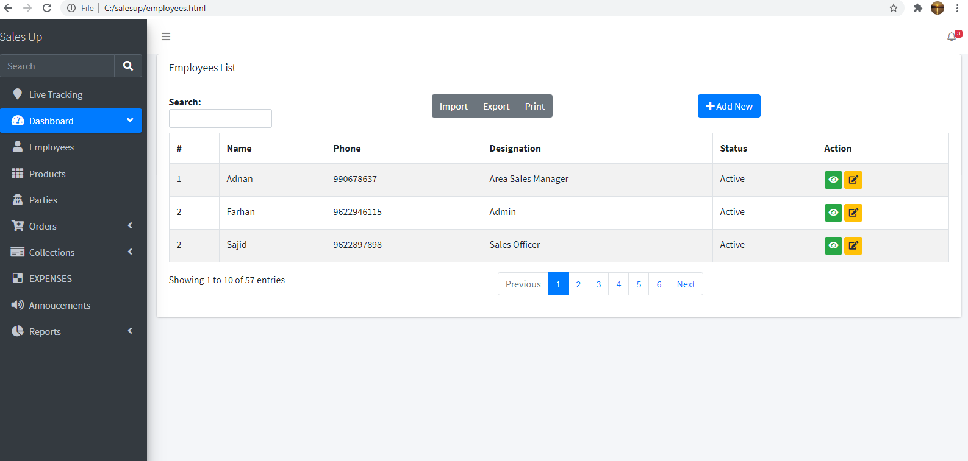
View Employees :admin will be able to view,edit delete employees

Slide 11
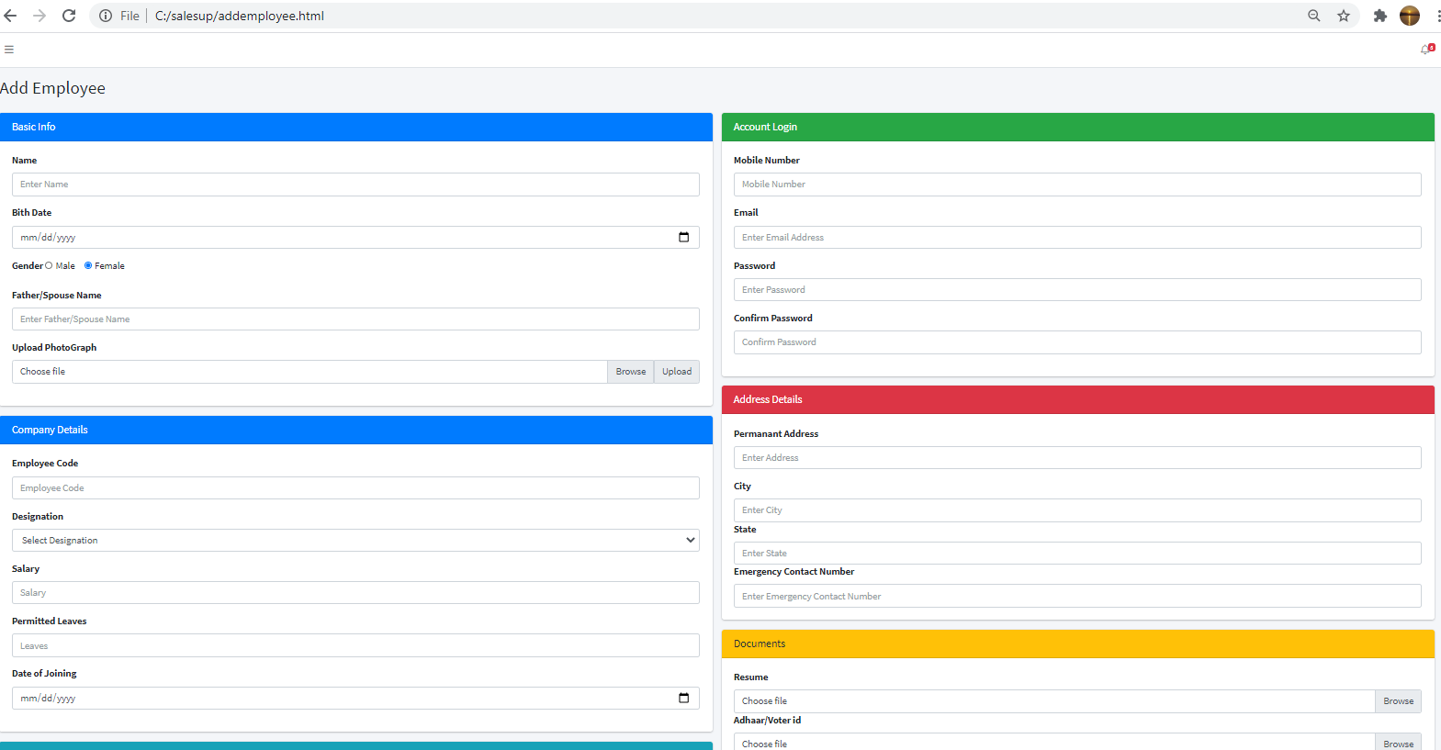
Add Employee :admin will be able to add employee

Slide 12
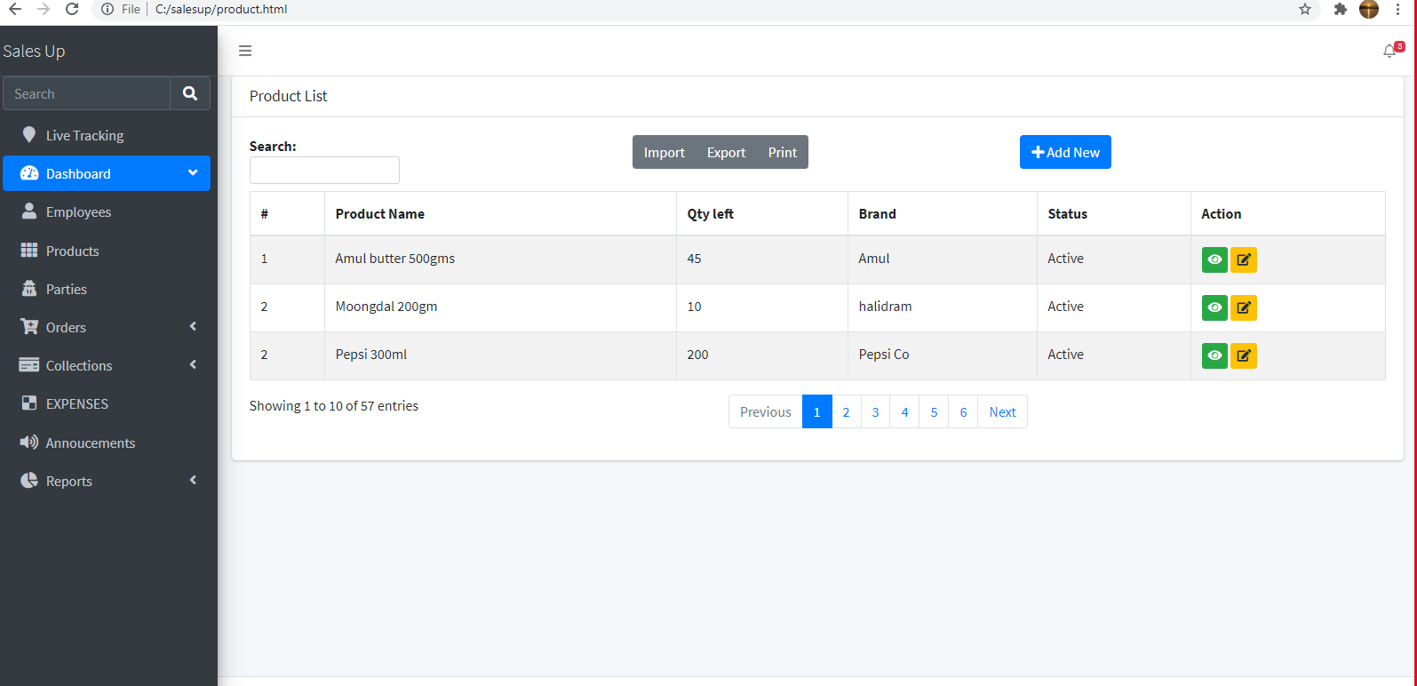
Products:admin/employee will be able to view products

Slide 13
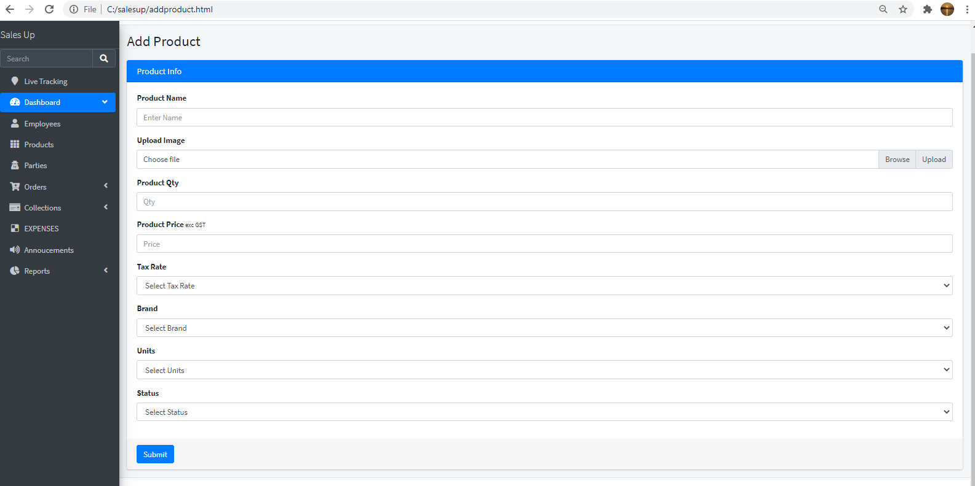
Add Products:admin will be able to add products

Slide 14
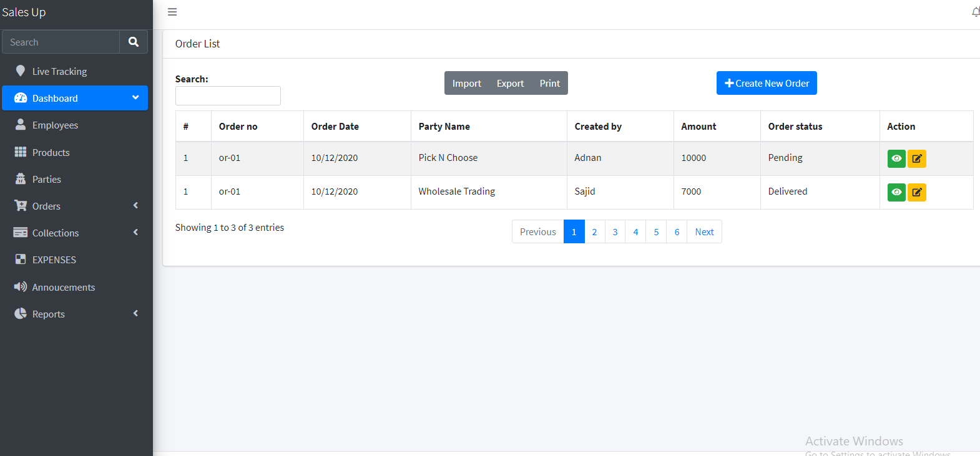
Orders:admin will be able to view orders

Slide 15
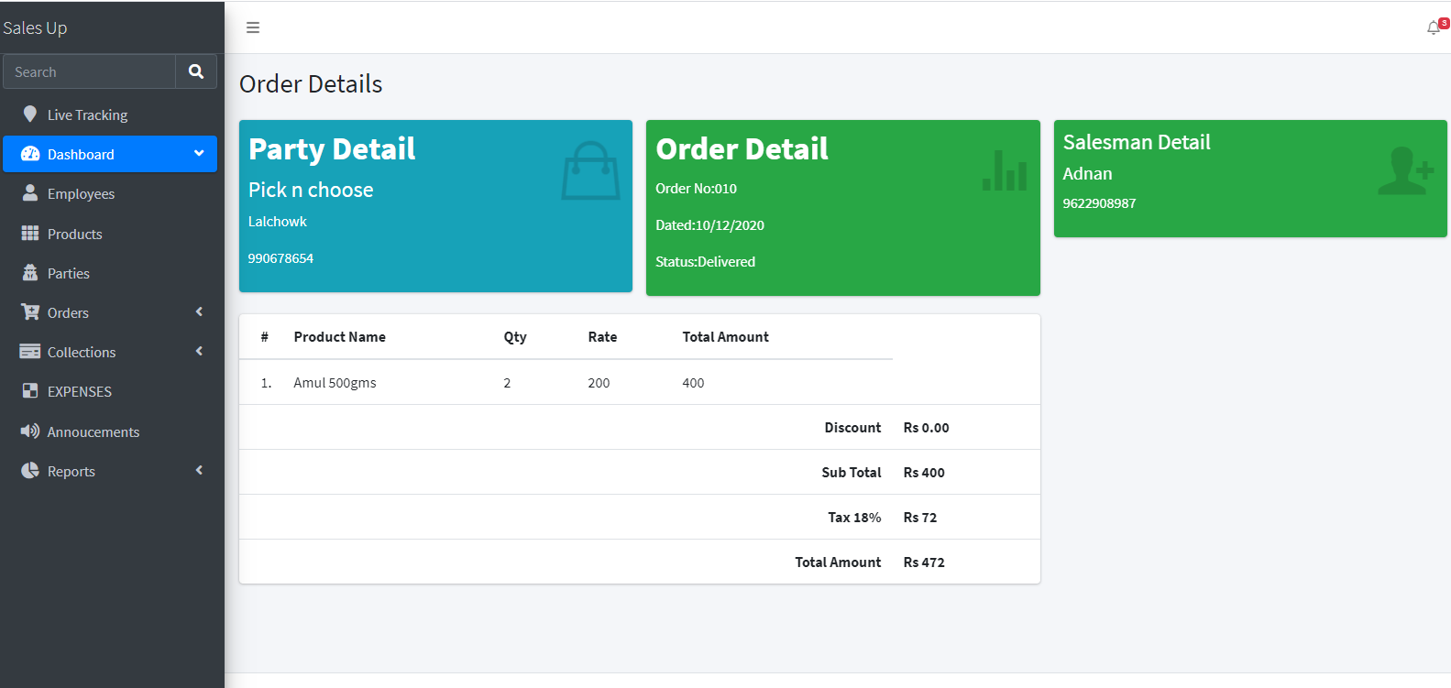
View Order Details :admin will be able to view complete order summary

Slide 16
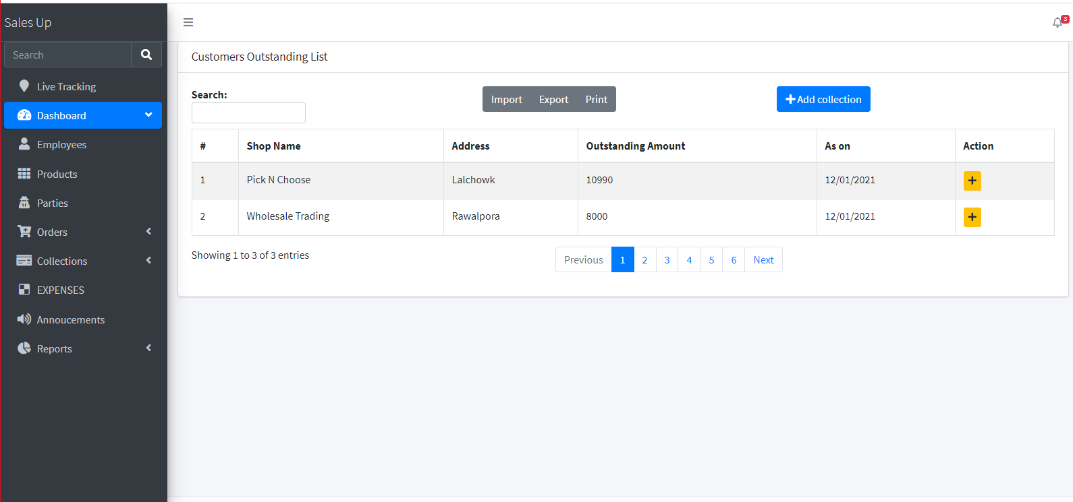
Oustanding list :admin/emp will be able to view outstanding of customers

Slide 17
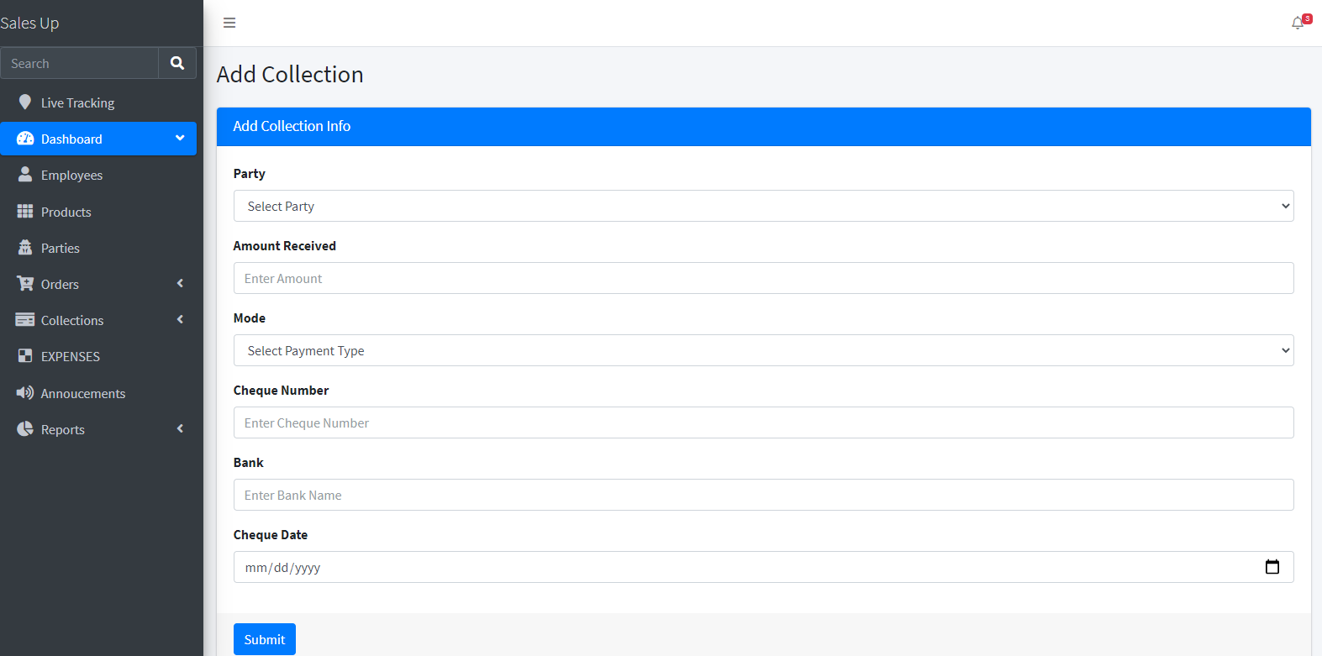
Add Collection

Slide 18
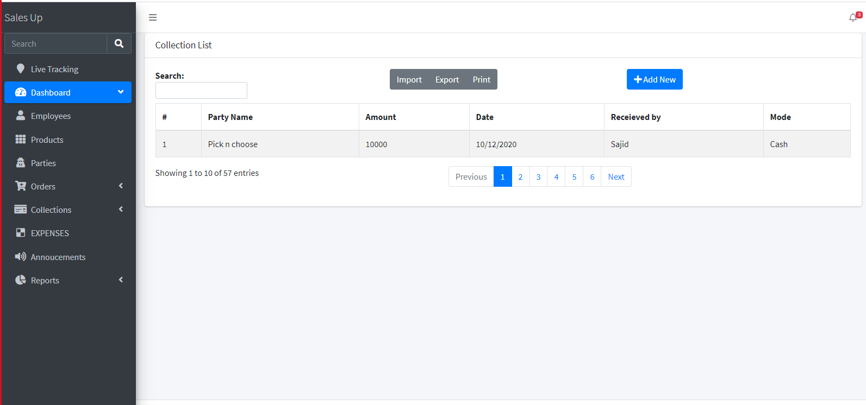
View collection

Slide 19
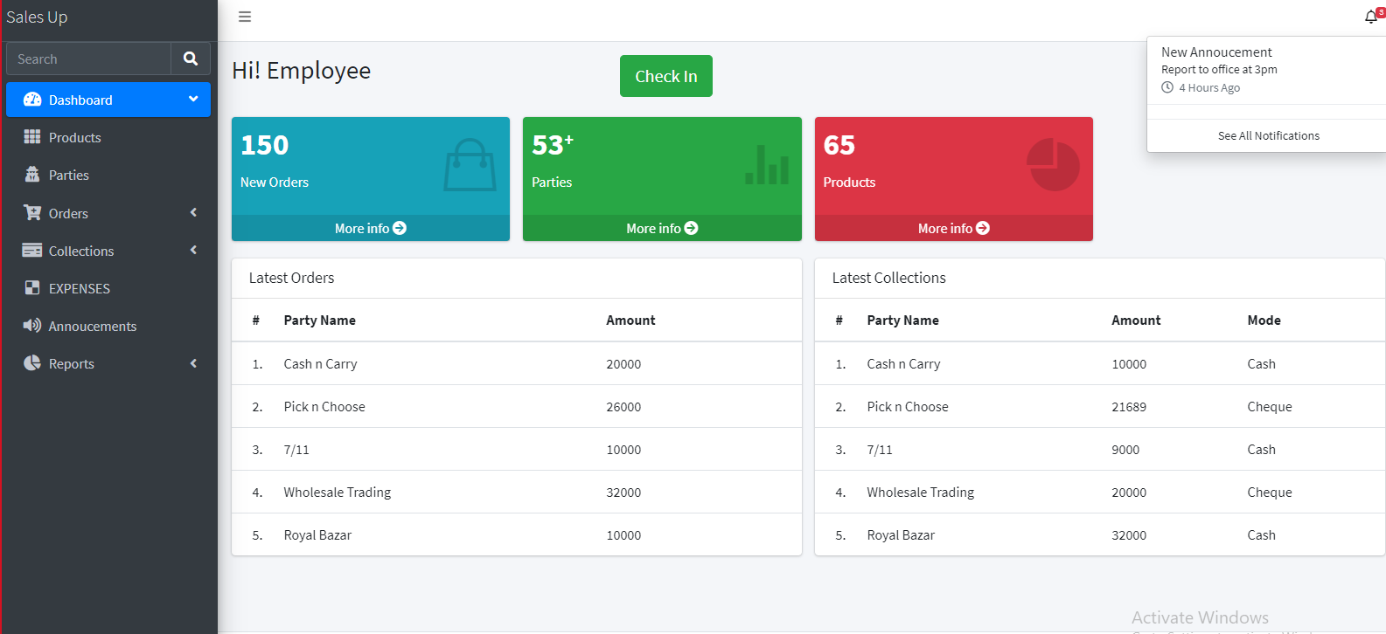
Employee Dashboard:Employee will be able to check in and do all other sales activities

Slide 20
.
Further there would be tabs for annoucements,expenses ,live tracking/feed and reports

Slide 21
THANK YOU

